Slide 1
FlexIS
Team members:
Fatima Binte Faiz Adreeta B1901898
Fong Ching Lin B1202348

Slide 2
Project Objectives
To develop a website that allows user to register employees, submit FWA requests, review the requests and view the analytics of FWA.
To develop a system that allows employees to update their daily schedule and keep track of their productivity.
To develop a user interface that is responsive and usable for all users.
To develop an intelligent database system that keeps track of employee records by analyzing their working schedule.

Slide 3
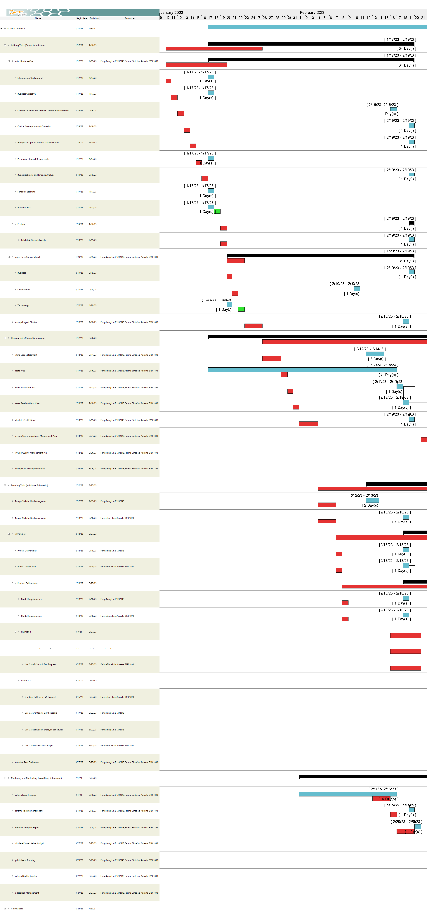
Tracking Gantt Chart (Assignment 1)

Slide 4
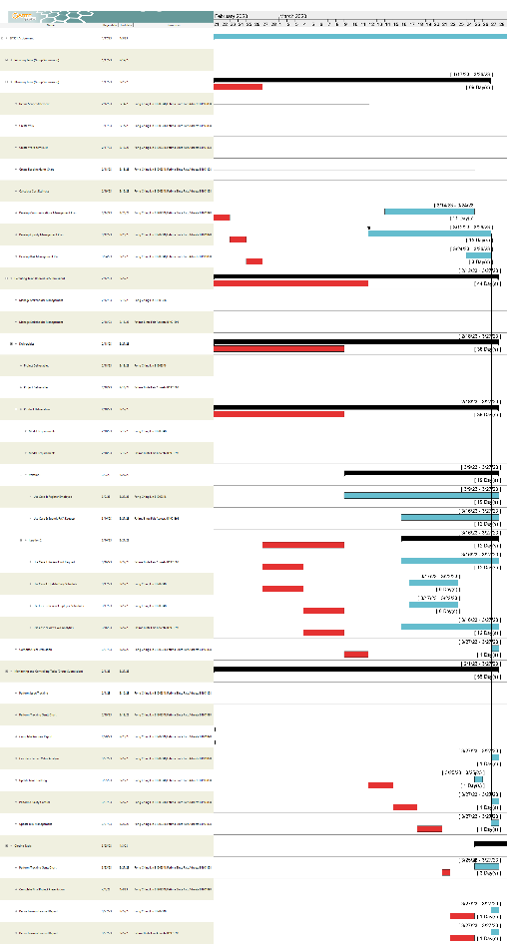
Tracking Gantt Chart (Assignment 2)

Slide 5
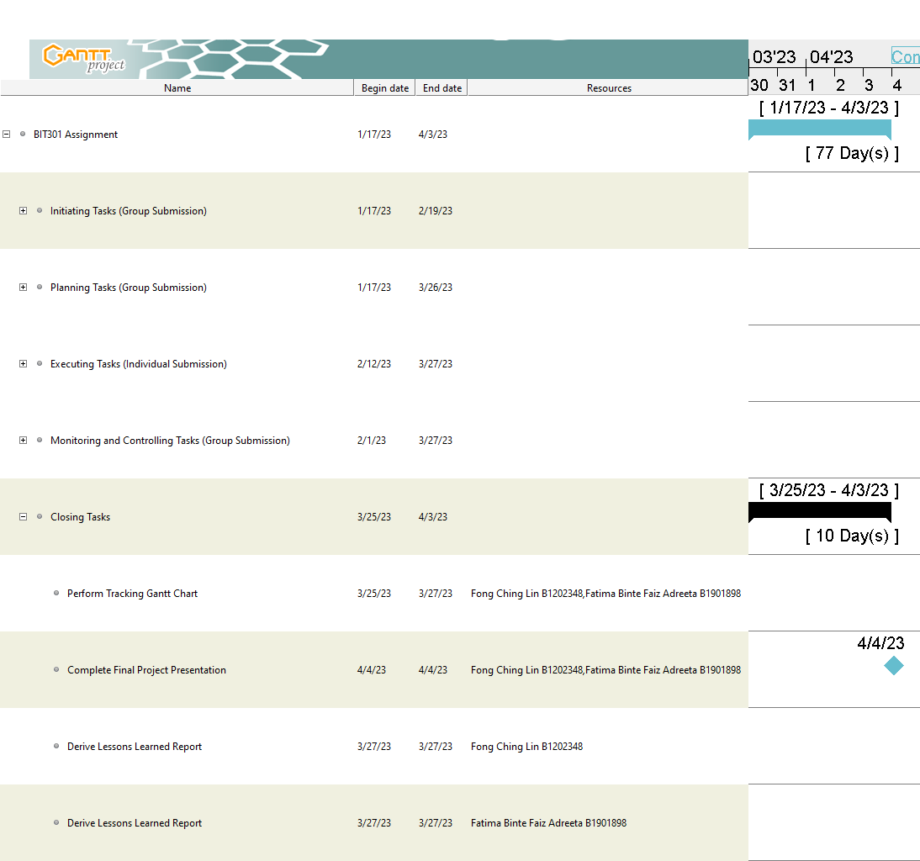
Tracking Gantt Chart (Final Project Presentation Due Date)

Slide 6
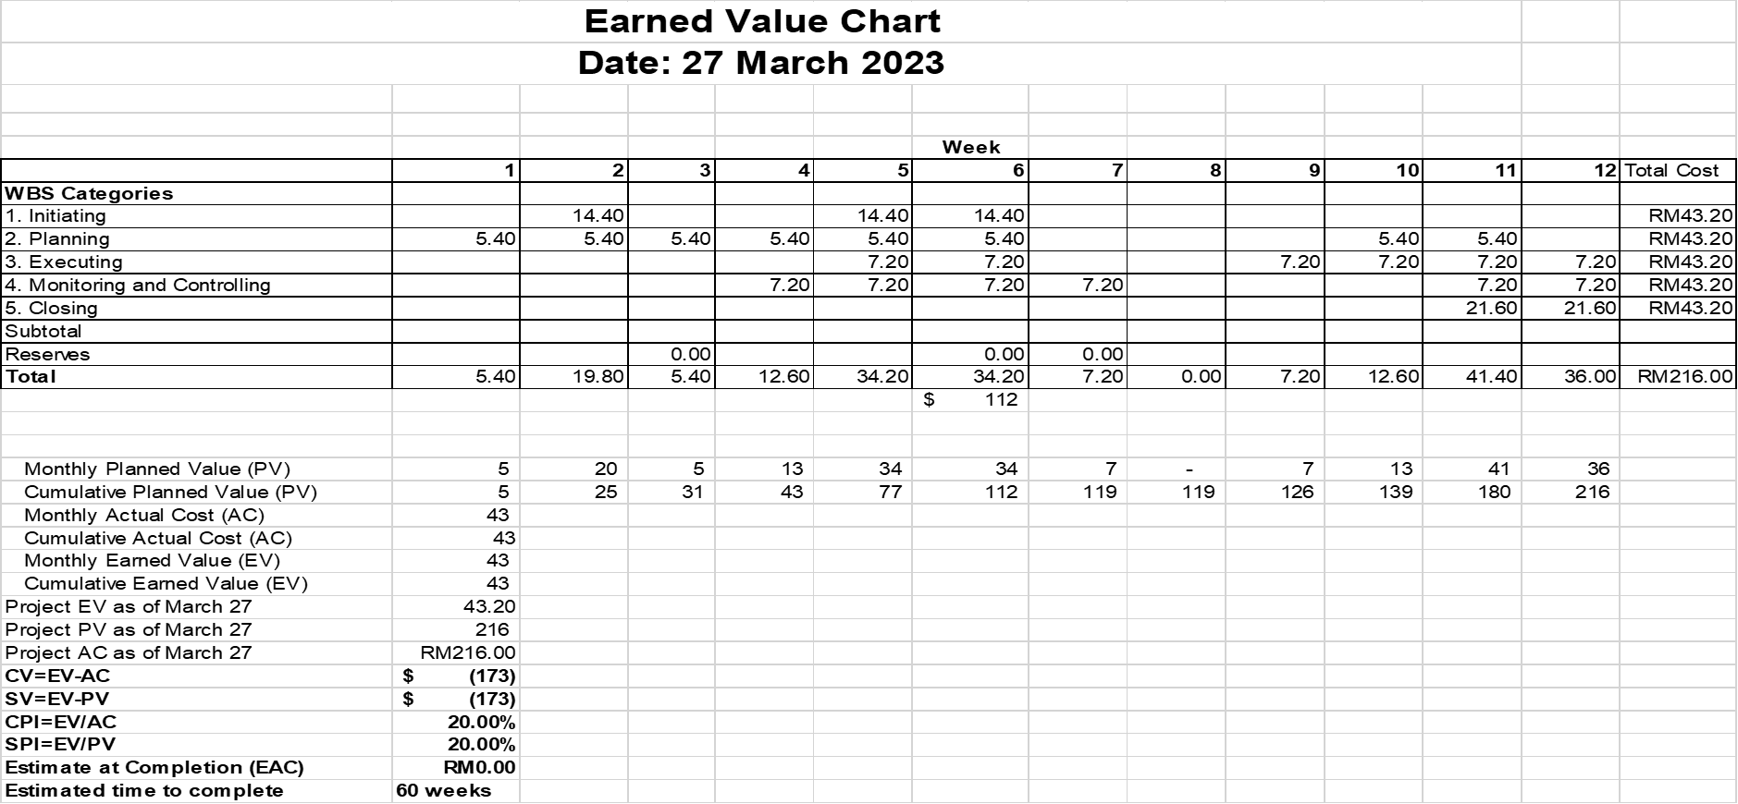
Planned vs Actual Cost

Slide 7
What went right
Use Case 1: Register Employee, Use Case 2: Submit FWA Request and Use Case 3: Review FWA Request are able to fulfill most of its functional and non-functional requirements.
Use Case 4: Update Daily Schedule, Use Case 5: Review Employee Schedules and Use Case 6: View FWA Analytics are able to fulfill all of its functional and non-functional requirements.

Slide 8
What went wrong
In Use Case 1: Register Employee, Use Case 2: Submit FWA Request and Use Case 3: Review FWA Request, the FlexIS website is unable to send an e-mail to the employee and the supervisor.
In Use Case 2: Submit FWA Request and Use Case 3: Review FWA Request, the FlexIS website is unable to request new employees to change their password after logging in to the website.
In Use Case 3: Review FWA Request, due to having no proper validation, an error will appear when the status is set to “rejected” and if the FWA table is empty, the table will show an error.

Slide 9


Was the Project a Success
All the use cases must be implemented and do their intended job.
All the functional and non-functional requirements of the system must be met.
The allocated budget must be the actual budget.
The actual profit gained must be more or less the expected profit.
Return on investment must be at least 70%.
The entire project life cycle must be finished by March 27, 2023.

Slide 10
Work Produced

Slide 11
Thank You

